Slide 1
Spring Boot

Slide 2
What is Spring Boot?
Spring Boot is a framework built on top of the Spring Framework that simplifies the development of Java-based web applications and microservices.
It eliminates most of the boilerplate configuration needed for traditional Spring applications.

Slide 3
Why Use Spring Boot?
Fast setup: Create production-ready apps quickly with minimal configuration.
Embedded servers: Comes with Tomcat, Jetty, or Undertow — no need to deploy WAR files manually.
Microservices ready: Ideal for building distributed systems.
Auto-configuration: Spring Boot automatically configures beans based on classpath and properties.
Actuator: Built-in endpoints to monitor and manage apps (health, metrics, etc.).
Integration: Works seamlessly with Spring Data, Security, Cloud, etc.

Slide 4
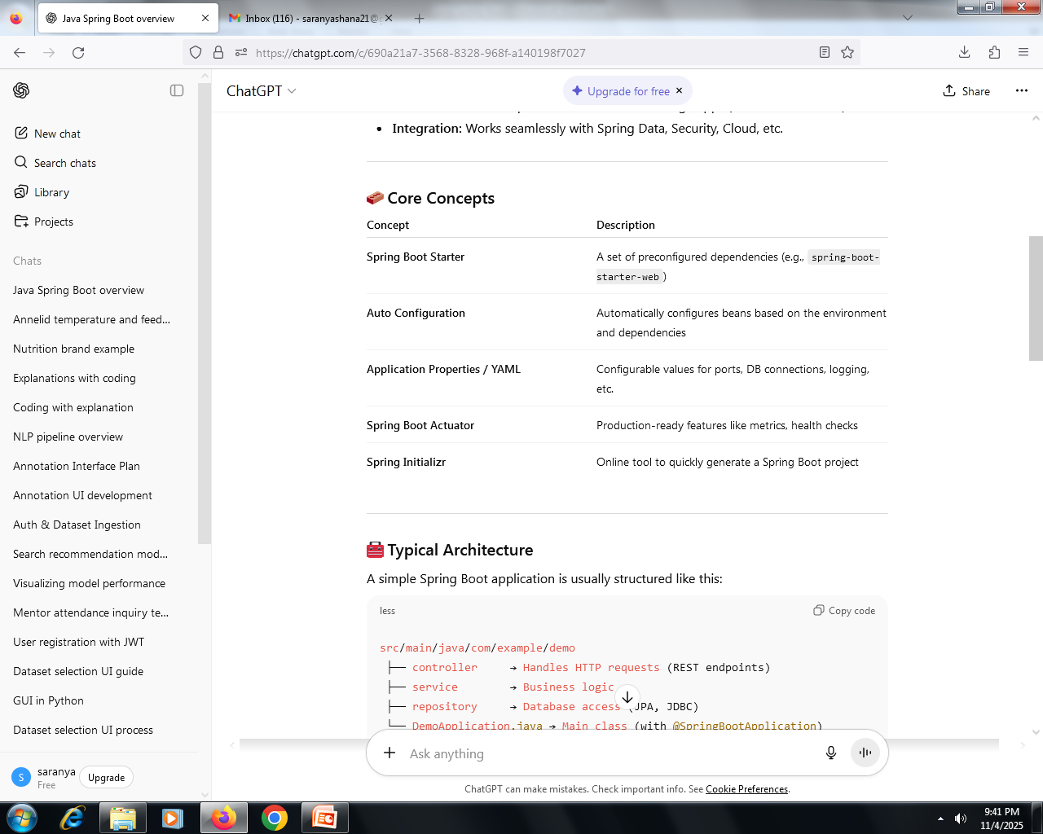

Slide 5
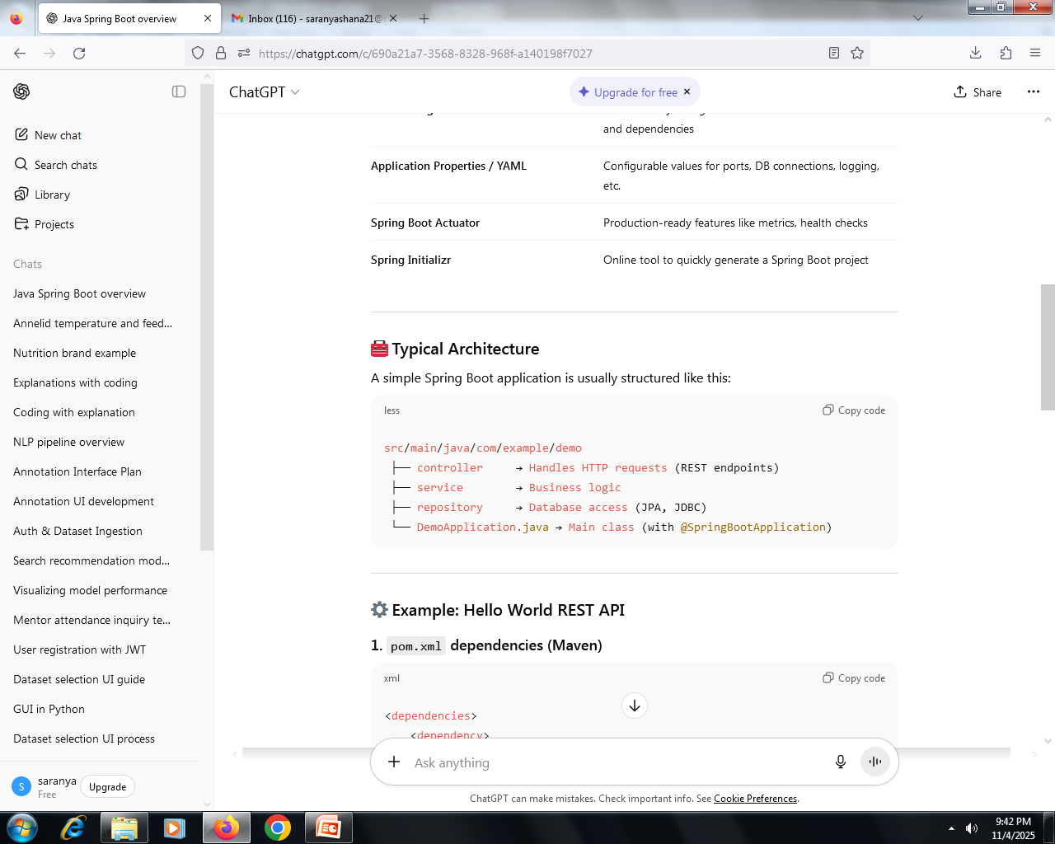

Slide 6
Example: Hello World REST API
1. pom.xml dependencies (Maven)
<dependencies>
<dependency>
<groupId>org.springframework.boot</groupId>
<artifactId>spring-boot-starter-web</artifactId>
</dependency>
</dependencies>

Slide 7
2. Main class
import org.springframework.boot.SpringApplication;
import org.springframework.boot.autoconfigure.SpringBootApplication;
@SpringBootApplication
public class DemoApplication {
public static void main(String[] args) {
SpringApplication.run(DemoApplication.class, args);
}
}

Slide 8
3. Controller
import org.springframework.web.bind.annotation.GetMapping;
import org.springframework.web.bind.annotation.RestController;
@RestController
public class HelloController {
@GetMapping("/hello")
public String sayHello() {
return "Hello, Spring Boot!";
}
}
Run this app → visit http://localhost:8080/hello
you’ll see: Hello, Spring Boot!

Slide 9
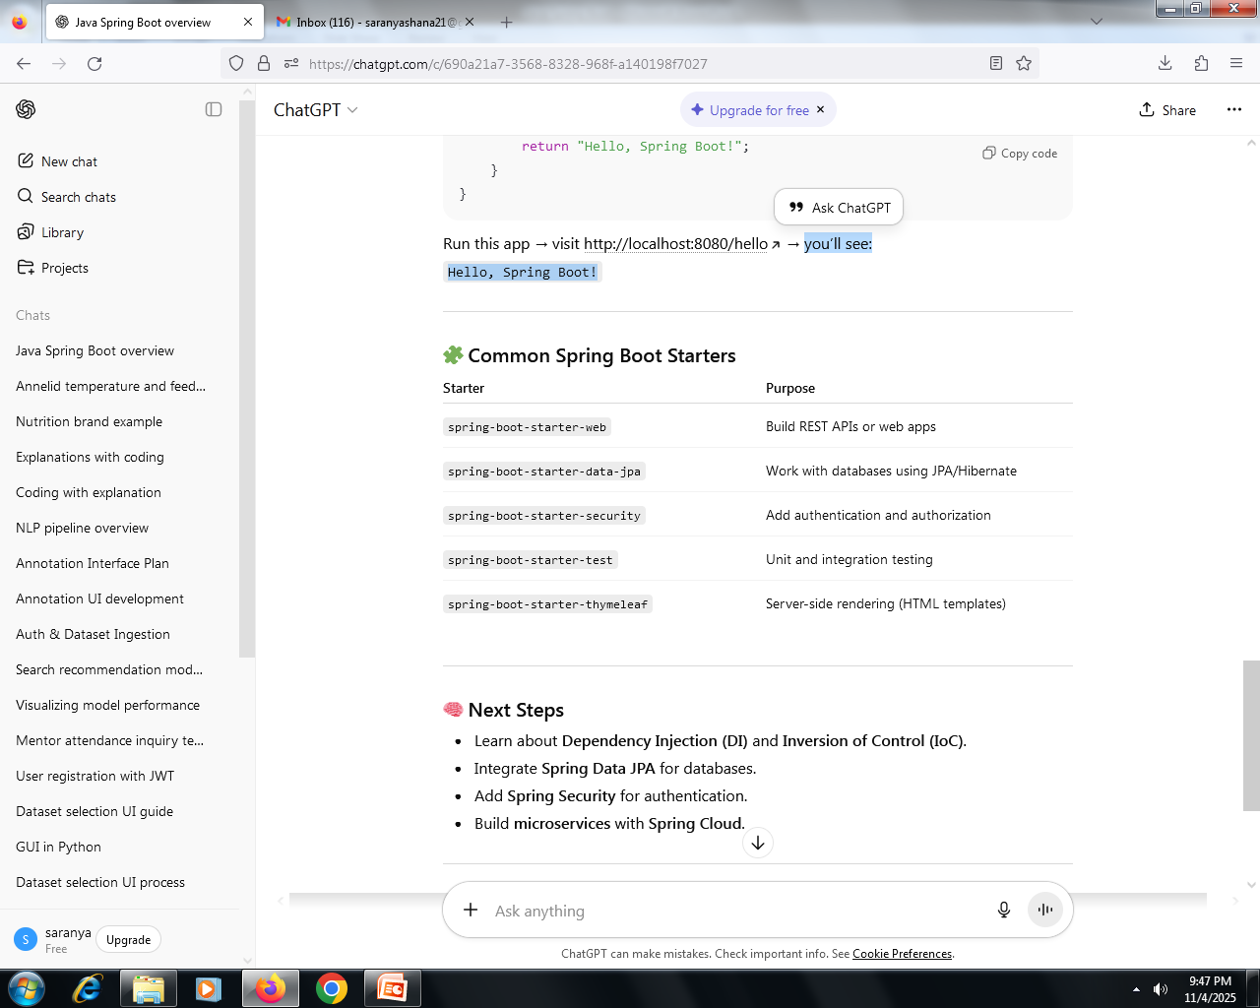

Slide 10
Next Steps
Learn about Dependency Injection (DI) and Inversion of Control (IoC).
Integrate Spring Data JPA for databases.
Add Spring Security for authentication.
Build microservices with Spring Cloud.

Slide 11
What is Flask?
Flask is a lightweight and flexible web framework for Python, designed to make it easy to build web applications, REST APIs, and backend services quickly.
It’s often called a “micro-framework” because it doesn’t force you to use specific tools or libraries — you can pick what you need.

Slide 12
Why Use Flask?
Lightweight: Minimal setup and no unnecessary overhead.
Flexible: You can structure your app the way you want.
Built-in development server: Easy to test locally.
Jinja2 templates: For dynamic HTML rendering.
REST API friendly: Perfect for building backend APIs.
Extensible: Add ORM (like SQLAlchemy), authentication, etc., as needed.

Slide 13
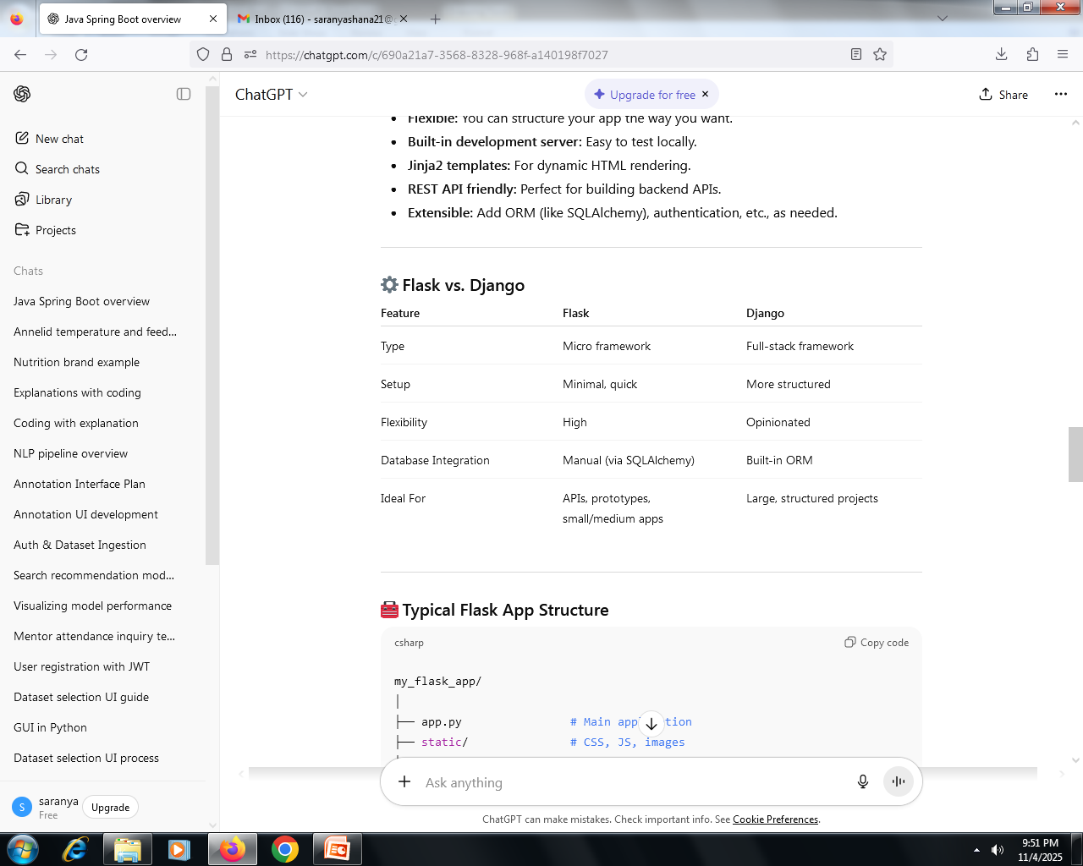

Slide 14
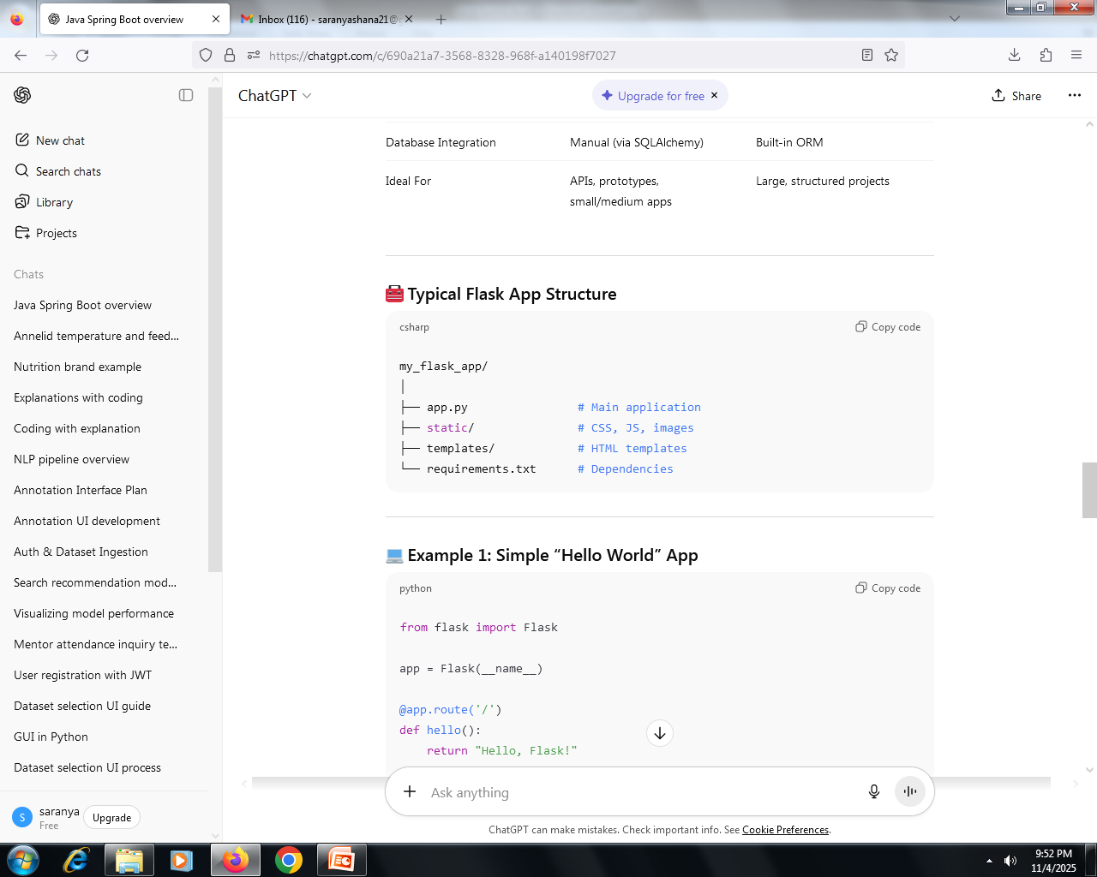

Slide 15
Example 1: Simple “Hello World” App
from flask import Flask
app = Flask(__name__)
@app.route('/')
def hello():
return "Hello, Flask!"
if __name__ == '__main__':
app.run(debug=True)
Run it:
python app.py
Then visit http://127.0.0.1:5000

Slide 16
Example 2: REST API (JSON Response)
from flask import Flask, jsonify
app = Flask(__name__)
@app.route('/api/user')
def get_user():
user = {"name": "Alice", "age": 25}
return jsonify(user)
if __name__ == '__main__':
app.run(debug=True)
Output:
{"name": "Alice", "age": 25}

Slide 17
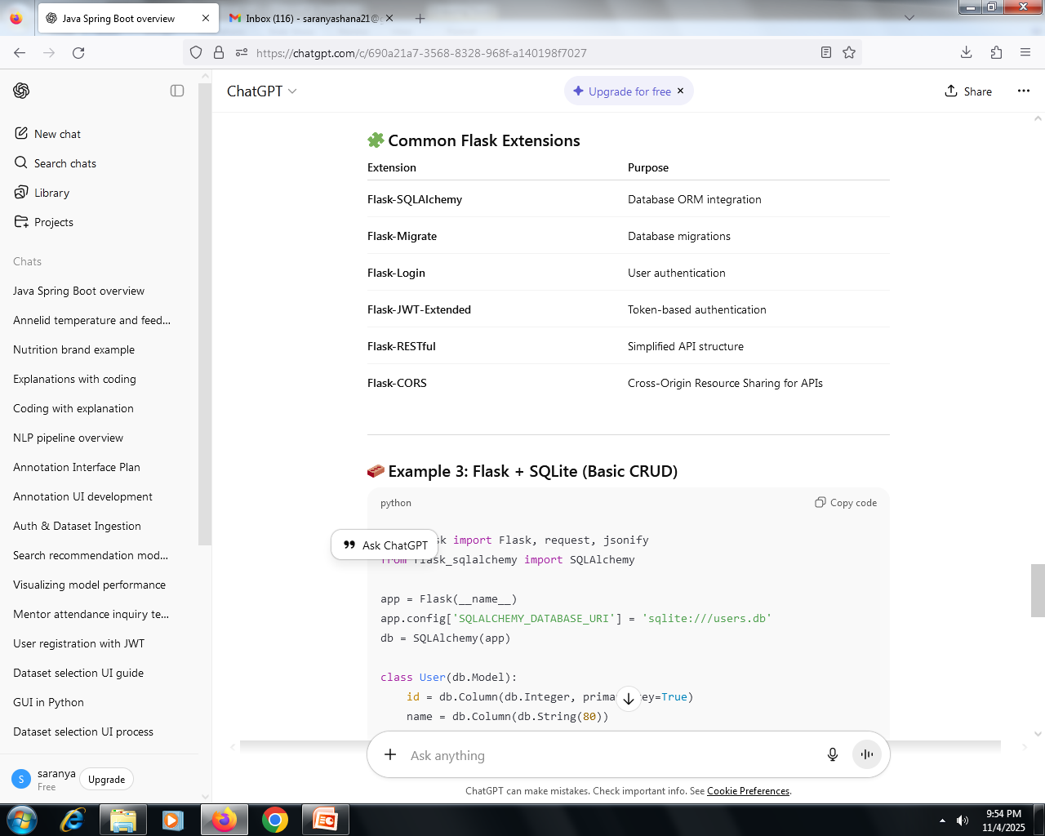

Slide 18
Example 3: Flask + SQLite (Basic CRUD)
from flask import Flask, request, jsonify
from flask_sqlalchemy import SQLAlchemy
app = Flask(__name__)
app.config['SQLALCHEMY_DATABASE_URI'] = 'sqlite:///users.db'
db = SQLAlchemy(app)
class User(db.Model):
id = db.Column(db.Integer, primary_key=True)
name = db.Column(db.String(80))
age = db.Column(db.Integer)
@app.route('/users', methods=['POST'])
def add_user():
data = request.json
new_user = User(name=data['name'], age=data['age'])
db.session.add(new_user)
db.session.commit()
return jsonify({"message": "User added!"})
@app.route('/users', methods=['GET'])
def get_users():
users = User.query.all()
return jsonify([{"id": u.id, "name": u.name, "age": u.age} for u in users])
if __name__ == '__main__':
with app.app_context():
db.create_all()
app.run(debug=True)

Slide 19
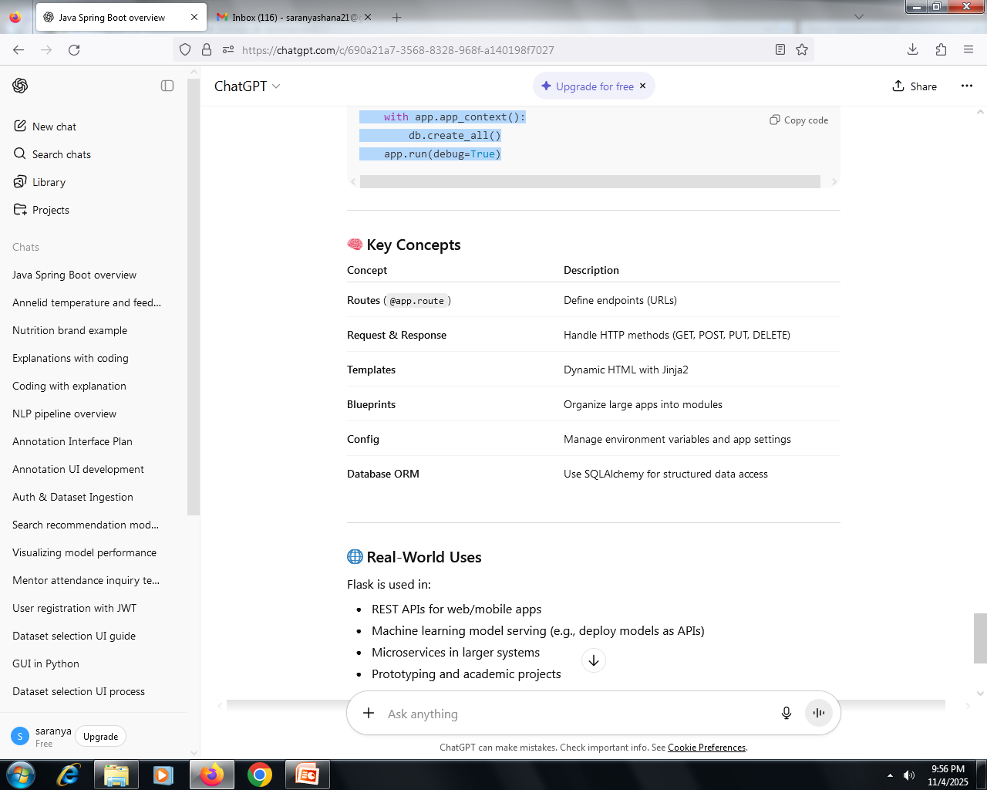

Slide 20
Real-World Uses
Flask is used in:
REST APIs for web/mobile apps
Machine learning model serving (e.g., deploy models as APIs)
Microservices in larger systems
Prototyping and academic projects

